Slide 1
Planning for Sustainability
The Okavango Delta Management Plan
Haretsebe Manwa

Slide 2
Learning Outcomes
After completing this case study, learners should be able to:
understand and apply stakeholder theory to analyse the complexities of integrating stakeholders in the development of the Okavango Delta Management Plan;
apply an integrated planning approach as stipulated by the Ramsar Convention to evaluate the Okavango Delta Management Planning process; and
propose appropriate strategies for the successful implementation of the Okavango Delta Management Plan.
The aim of the case study is to provide an opportunity for students to understand, apply and critically evaluate best practices in Integrated planning process using the Okavango Delta Management Planning process in Botswana as an example.

Slide 3
Background
The Ramsar Convention
The Okavango Delta and Botswana's tourism industry
Stakeholder theory and the Okavango Delta stakeholders
Legislative frameworks
Okavango Delta Management planning process
Challenges and opportunities

Slide 4
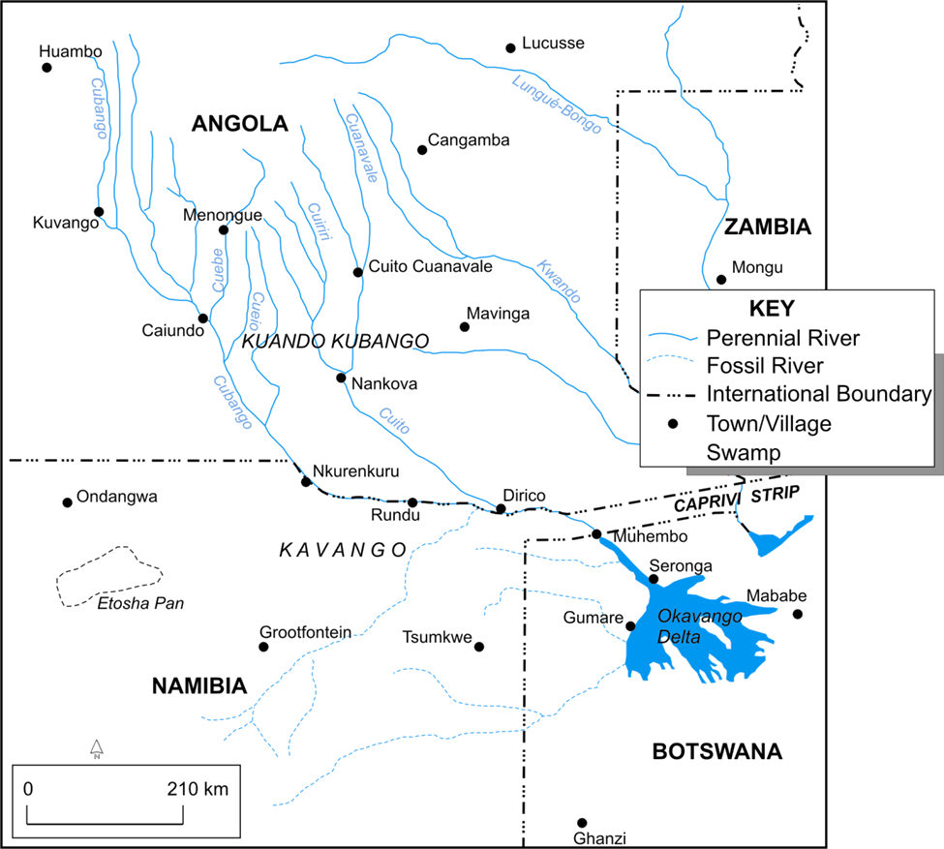
Okavango Delta Location

Slide 5
The Ramsar Convention
Ramsar Convention Mission:
"The conservation and wise use of all wetlands through local, regional, and national actions and international cooperation, as a contribution towards achieving sustainable development throughout the world”

Slide 6
The Ramsar Convention
Article 2 of the convention
Listing of wetlands of International importance to promote their conservation
To continue to designate suitable wetlands within its territory for the list
site selection based on its significance (ecology, botany, zoology, limnology or hydrology)
Article 3 of the Convention
Commitment to include wetland conservation in national planning process
Commitment to formulate and implement management plans to demonstrate "the wise use of wetlands in their territory"
Article 5 of the Convention
International cooperation in implementing the Convention (Transboundary wetlands).

Slide 7
The Ramsar Convention
Botswana ratified and acceded to the Convention in April 1997.
The Okavango delta was then listed as a Ramsar Site.
Tri-country agreement, between Angola, Botswana & Nambia
to establish The Permanent Okavango River Basin Water Commission (1994).
A collaborative body known as OKACOM was formed.

Slide 8
Okavango Delta & Botswana's Tourism
Is a competitive tourist destination in the Botswana market
Significant contribution to GDP (6%)
The only permanent large body of surface water within Botswana
A concentration of natural resources and ecosystem services surrounded by the resource-poor environment of the semi-arid Kalahari
Vision statement for tourism development:
To strive for the development of a world class nature based tourism destination that is economically sustainable and optimises benefits to local communities and the nation within agreed limits of acceptable change

Slide 9
Macro-economic impact of the OD
2005 | Direct GNP (1000 Pula) | Income multiplier (1000 Pula) | Indirect + Indirect GNP (1000 Pula)
RAMSAR SITE
Tourism | 400,970 | 2.58 | 1,032,870
Agriculture/natural resource use | 73,600 | 2.03 | 149,340
WETLAND
Tourism | 362,540 | 2.58 | 936,190
Agriculture/natural resource use | 16,990 | 1.64 | 27,810

Slide 10
Okavango Delta Stakeholders
Primary stakeholders
Communities living in the OD
Community-based organisations
Village Development committees
Conservation committees
Community trusts/committees
Secondary stakeholders
Upstream communities (Angola)
NGOs (community-based)
Tour operators in the Delta

Slide 11
Okavango Delta Stakeholders
Tertiary stakeholders
Government institutions (Angola, Botswana, Namibia)
International/national donor agencies
The Ramsar Bureau
IUCN
Tourists
See Freeman (1984) for a definition of a stakeholder

Slide 12
Legislative Frameworks
National and international frameworks that influenced the development of the Okavango Delta Management Plan
Permanent Okavango River Basin Water Commission of 1994 (OKACOM)
Composition: representatives of 3 riparian states
Overseer of sustainable management of Okavango Delta
Botswana’s Vision 2016 (Long-term Vision for Botswana, 1997)
The Draft Botswana National Wetlands Policy of 2002
Ngamiland District Development Plan

Slide 13
Other Issues leading to the OMDP
Poverty levels in Ngamiland
Pressure on natural resources
Land degradation from livestock and wildlife
Invasive alien species(e.g. Salviniamolesta)
Competing commercial and traditional use interests
Human-wildlife conflicts
Limited information and data management to inform planning
Undirected strategy for tourism
Trans-boundary, fugitive resources (water and wildlife)
Upstream developments
Pressure on natural resources

Slide 14
ODMP Formulation
Formation of Task Teams (12)
Multi-uses of resources
Experts in the identified area
Relevant government department
Technical support
Drafting of terms of reference
Consultations with Primary Stakeholders
A Steering Committee
Permanent secretaries and directors of the departments
District Level
Okavango Delta Wetland Management committee.

Slide 15
ODMP Formulation
Issues to be addressed by task groups and stakeholders
Situational analysis
Ecosystem approach to resource management
Inception report (2004)
Final ODMP (2007)

Slide 16
ODMP Implementation Strategy
Coordinating Authority | Department of Environmental Affairs
Implementing Agencies | Sectoral Departments
Planning Horizon | 6-year planning cycle
Plan Implementation | Mainstreamed (normal NDP)
Financial Resources | Normal government budgetary procedures
Plan Review | Normal mainstreamed

Slide 17
Lessons & Challenges
Lessons
Buy-in of stakeholders
Capacity building especially communities
Information and education
Coordination and integration (institutional structures)
Indigenous knowledge systems
Replication by Angola and Namibia?
Challenges
Implementation challenges
Exogenous factors, e.g. climate change
Financial resources and political will

Slide 18
Study Questions
Debate the stakeholder theory and identify likely conflicts among stakeholders. Also show why stakeholders play an important role in achieving sustainable tourism development.
Identify the key stakeholders of the Okavango Delta. What were their roles in Okavango Delta Management planning process? What are likely challenges in integrating stakeholders’ interests in the Okavango Delta Management planning process?
Familiarise yourself with the Ramsar Convention guidelines on integrated planning process on URL: http://www.ramsar.org/pdf/lib/hbk4-02.pdf). Debate Ramsar guidelines on integrated planning approach.
Use the Ramsar guidelines to suggest improvements in the implementation of the Okavango Delta Management Plan.
What are some of the lessons from the case which can be used to inform future plans in other countries?

Slide 19
Reading
Visit the following websites and the case study for additional information on the Okavango Delta and the Okavango Delta Management Plan and Ramsar Convention:
http://www.ramsar.org/pdf/wurc/wurc-mg
http://www.botswanatourism.co.bw
http://www.mewt.gov.bw/DEA

